Slide 1
13. 实例分割 Instance Segmentation
罗志明
zhiming.luo@xmu.edu.cn

Slide 2
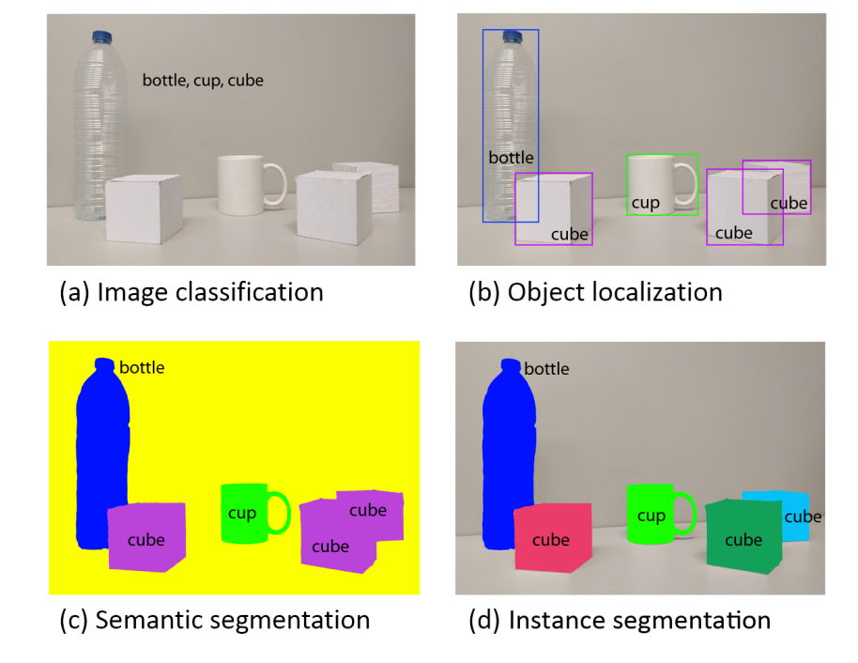
实例分割 (Instance Segmentation)

Slide 3
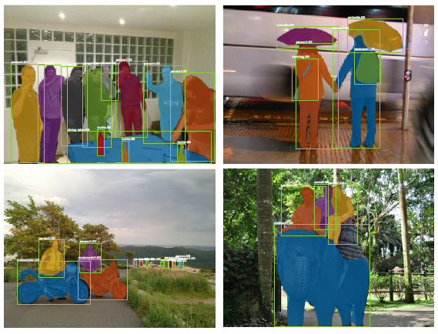
实例分割 (Instance Segmentation)
检测目标实例、分类，并识别对应的前景像素
语义标签：语义类别、实例ID
不识别背景类

Slide 4
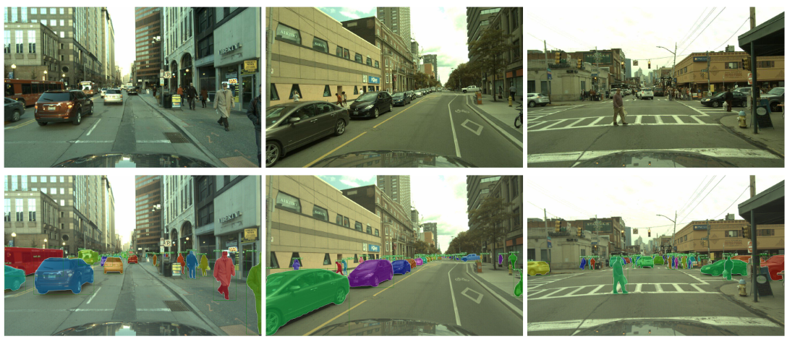
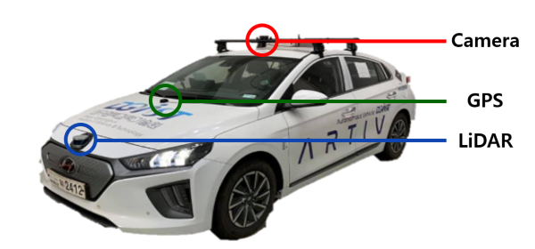
实例分割 – 应用
Autonomous Driving

Slide 5
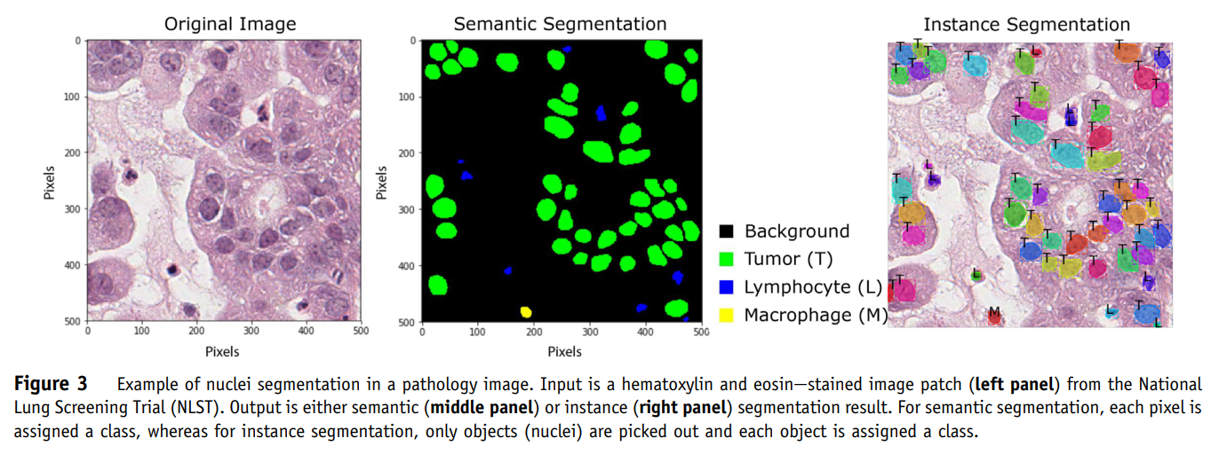
实例分割 – 应用
Wang, et al. Pathology Image Analysis Using Segmentation Deep Learning Algorithms, The American Journal of Pathology 2019

Slide 6
数据集 (Dataset)
Microsoft COCO
LVIS
KITTI
Cityscapes
…

Slide 7
代表性方法
Multi-task Cascades
Mask R-CNN

Slide 8
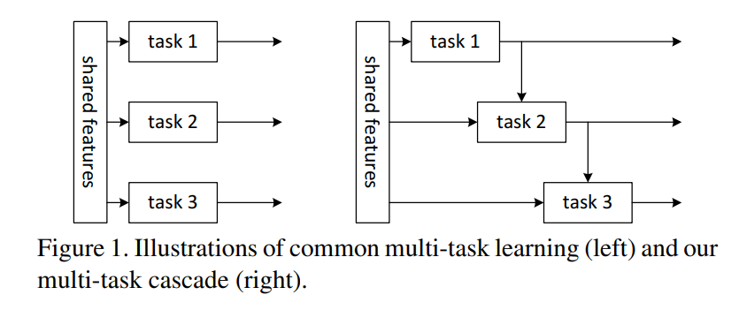
Multi-task Cascades
Instance Segmentation
Task 1: differentiating instances
Task 2: estimating masks
Task 3: categorizing objects
Dai, et al. Instance-aware Semantic Segmentation via Multi-task Network Cascades, CVPR 2016

Slide 9
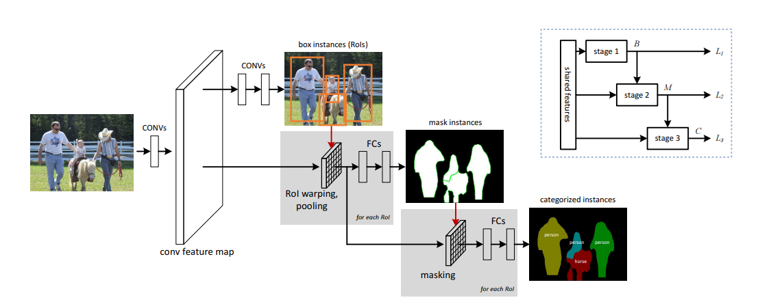
Multi-task Cascades
Dai, et al. Instance-aware Semantic Segmentation via Multi-task Network Cascades, CVPR 2016

Slide 10
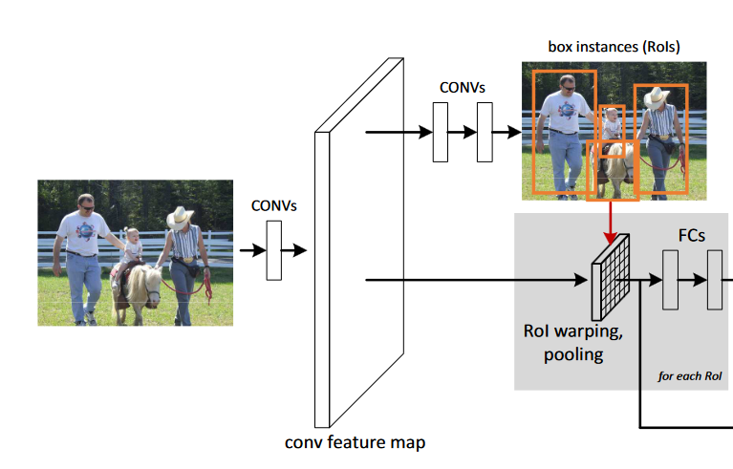

Task 1: differentiating instances
Region Proposal Networks (RPN)
共享Conv特征
Conv Layers
1st: 3*3的卷积核降低特征维度
2nd: Bbox回归 & Objectness得分
损失函数

Slide 11
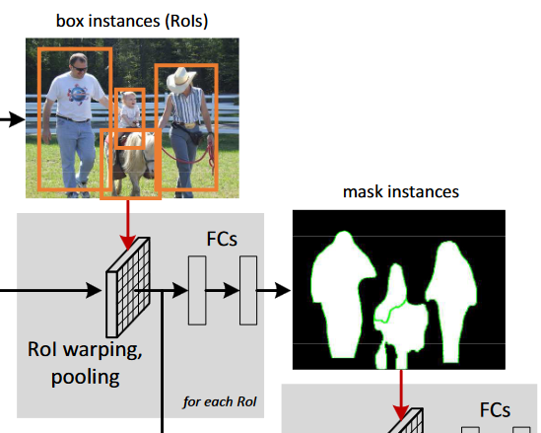

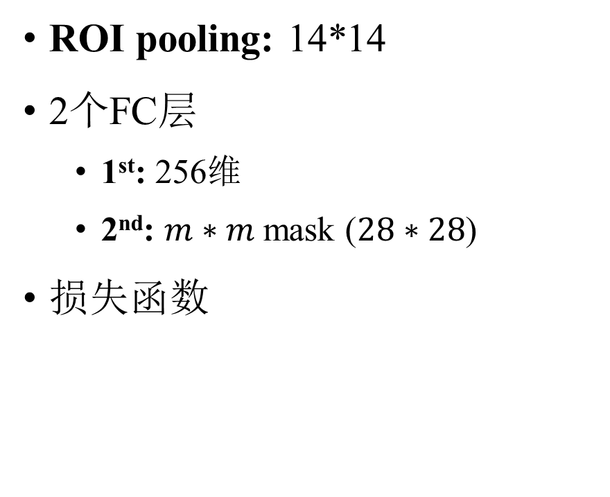
Task 2: estimating masks
ROI pooling: 14*14
2个FC层
1st: 256维
2nd: $m∗m$mask ($28∗28$)
损失函数

Slide 12
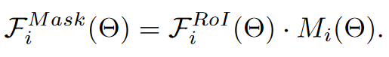
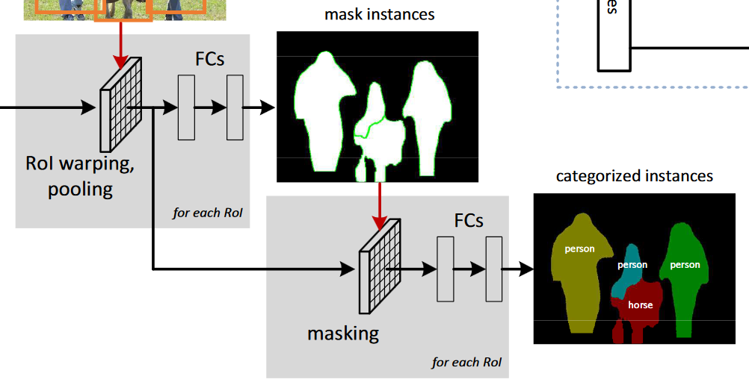

Task 3: categorizing objects
Masked特征
分类
Mask-based & Box-based两个分支
每个分支两个4096-d FC层
Concatenation & Softmax classifier
损失函数

Slide 13
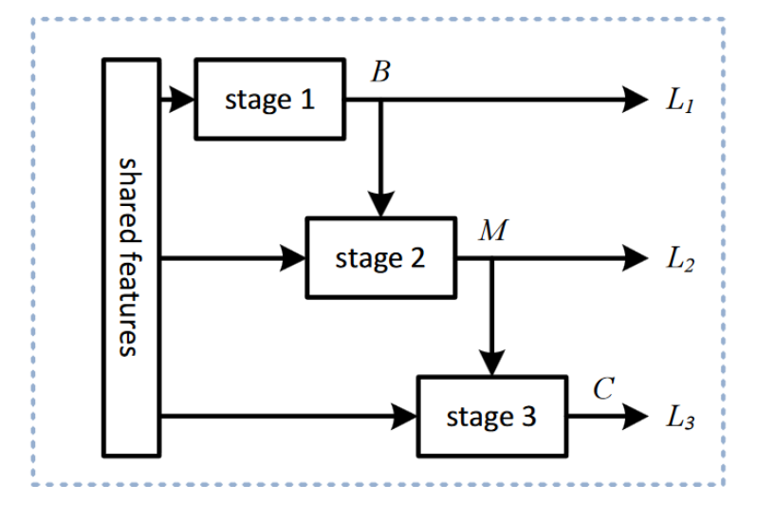
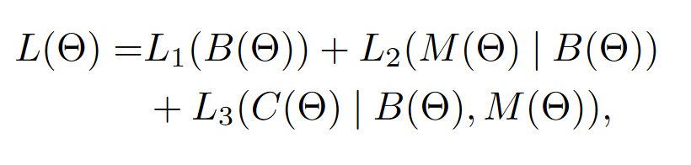
目标损失函数

Slide 14
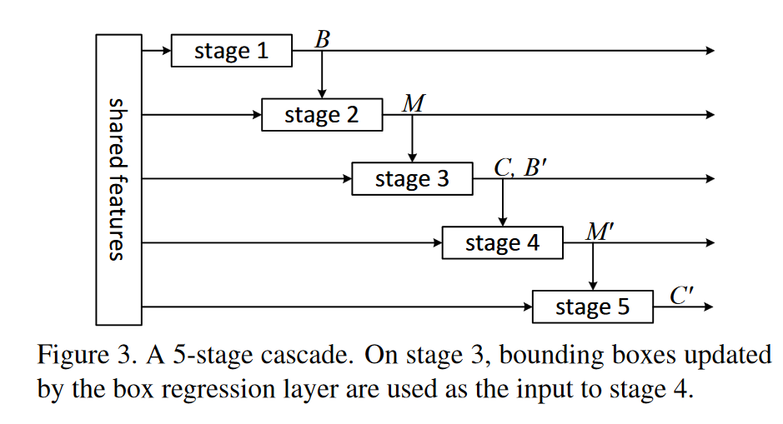
More Stages

Slide 15
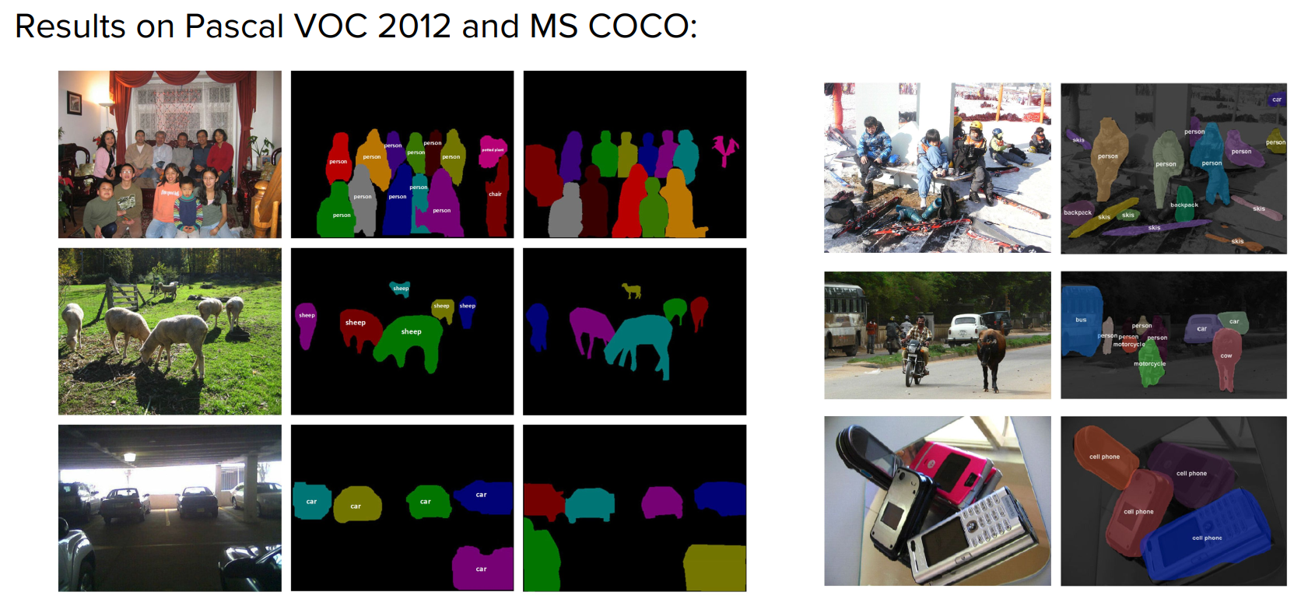
分割结果
Dai, et al. Instance-aware Semantic Segmentation via Multi-task Network Cascades, CVPR 2016

Slide 16
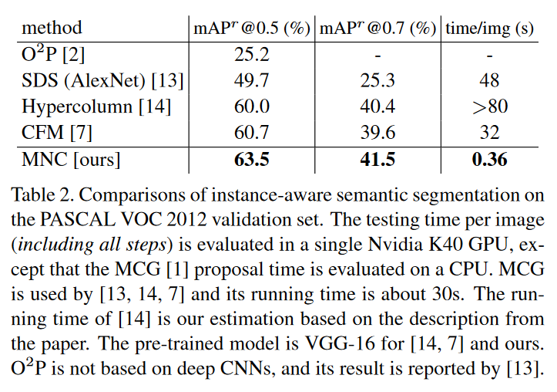
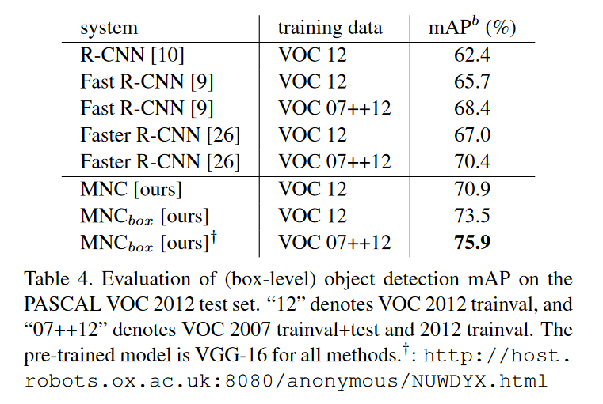
实验结果

Slide 17
代表性方法
Multi-task Cascades
Mask R-CNN

Slide 18
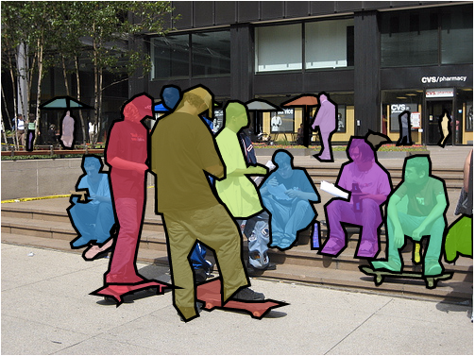
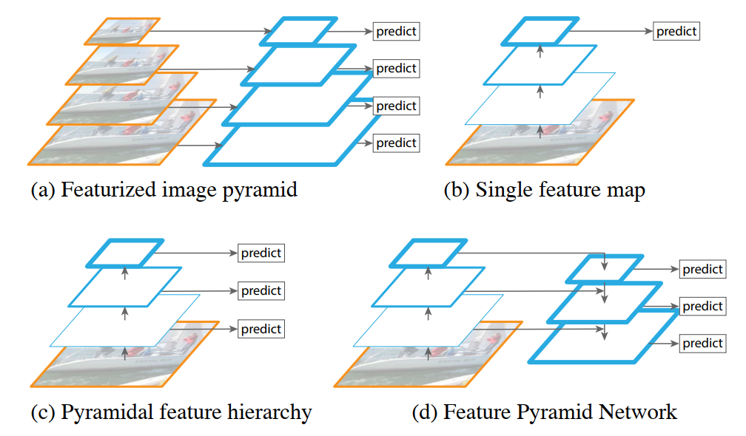
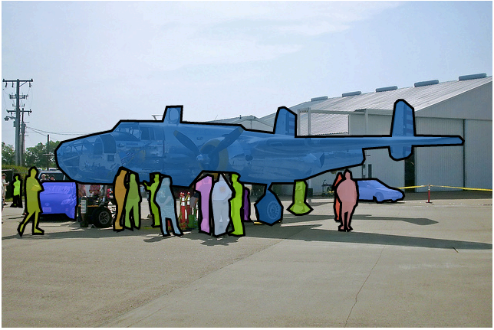
Feature Pyramid Networks (FPN)
Lin et al. Feature Pyramid Networks, CVPR 2017

Slide 19
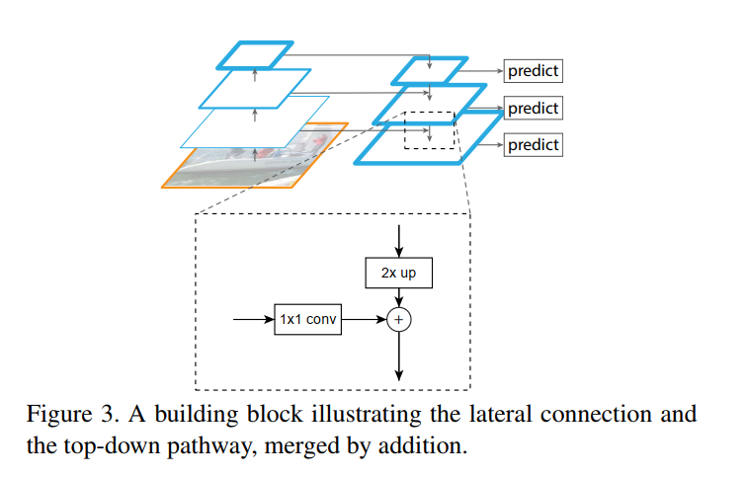

FPN – 实现细节
Bottom-up pathway
ResNets: $\{C_{2},C_{3},C_{4},C_{5}\}$
Strides: $\{4, 8,16,32\}$
Top-down pathway
$3∗3$ conv with $d=256$
$\{P_{2},P_{3},P_{4},P_{5}\}$
Lateral connections
Nearest neighbor upsampling
1*1 conv & addition

Slide 20
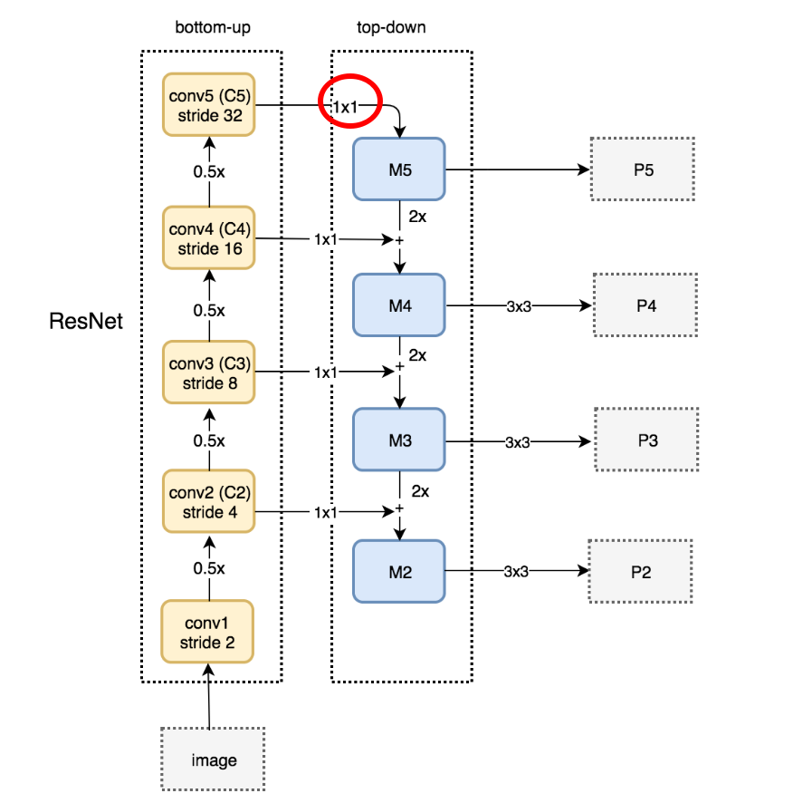
FPN – Implementation details

Slide 21
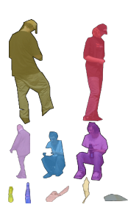
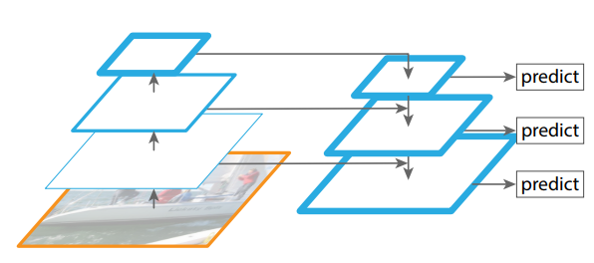
FPN – Multiscale Representation
利用ConvNet中的层次特征生成语义信息更强的多尺度特征
增加的少量的计算量
End-to-end learning

Slide 22
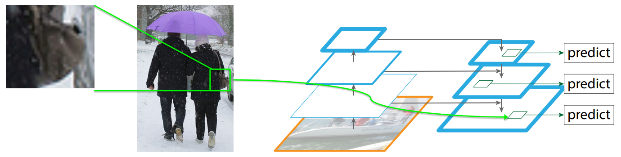
FPN – Small Objects
FPN提升small objects的检测性能
Top-down可以提取上下文信息
增加了特征的分辨率

Slide 23
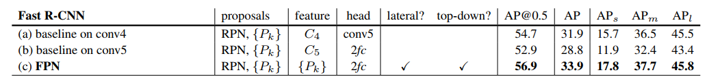
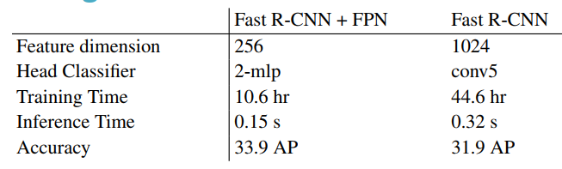
实验结果 (Fast R-CNN+FPN)

Slide 24
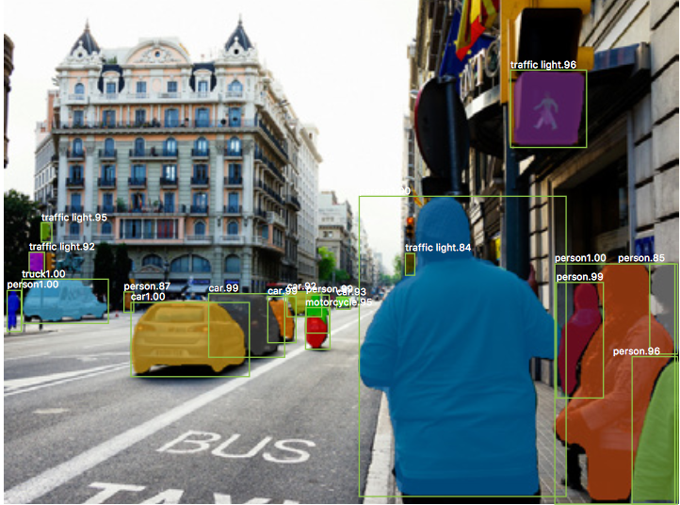
Mask R-CNN
将Faster R-CNN扩展用于实例分割
He, et al. Mask R-CNN, ICCV 2017

Slide 25
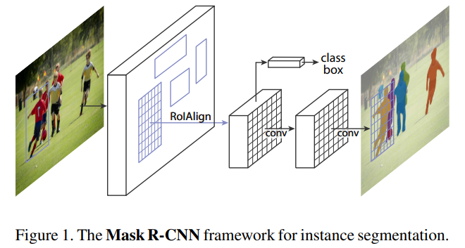
Mask R-CNN
将Faster R-CNN扩展用于实例分割：Faster R-CNN + FCN

Slide 26
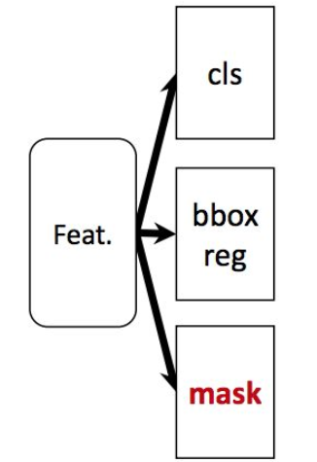
Mask R-CNN
Faster R-CNN + FCN：并行的结构
Faster R-CNN
FCN

Slide 27
Mask R-CNN: Mask Branch
FCN

Slide 28
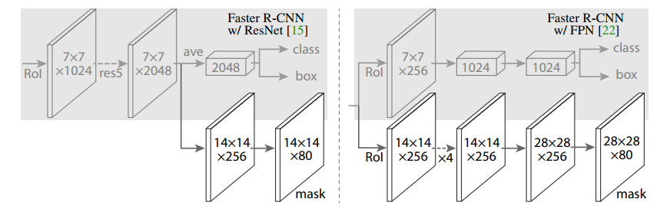
Mask R-CNN: Network Architecture
骨干网络：ResNet + FPN
Mask Head结构

Slide 29
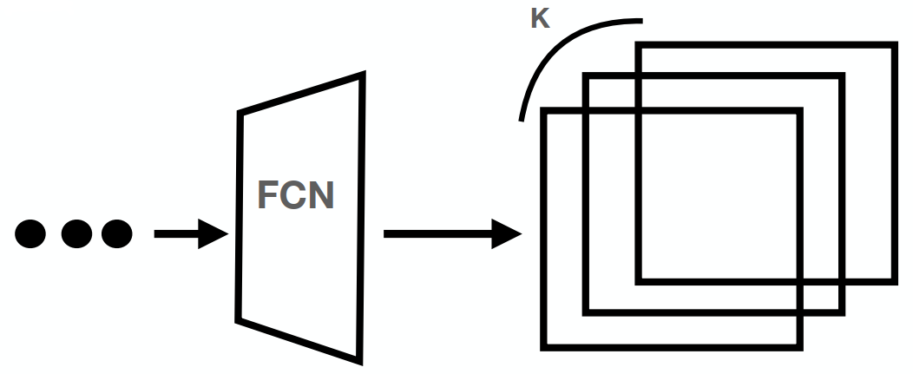

Mask R-CNN: Mask Head
K个$m∗m$分割图
采用Sigmoid得到概率
Multi-class vs Multi-label

Slide 30
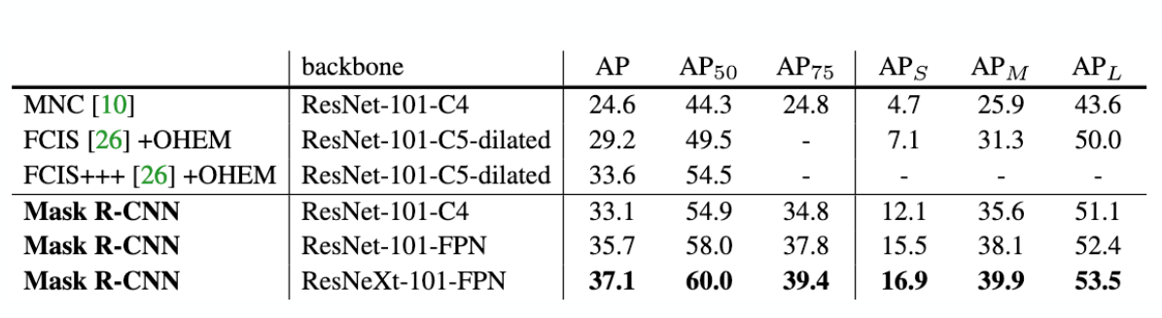
Mask R-CNN: Result
Achieve SOTA results with a simple extension

Slide 31
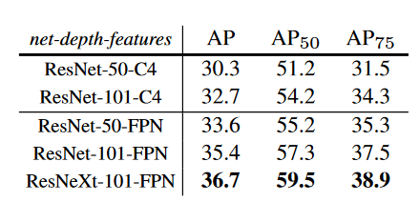
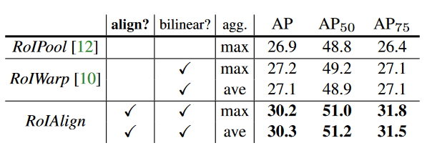
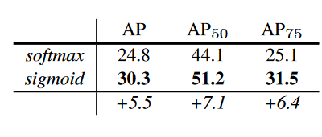
Mask R-CNN: Result

Slide 32
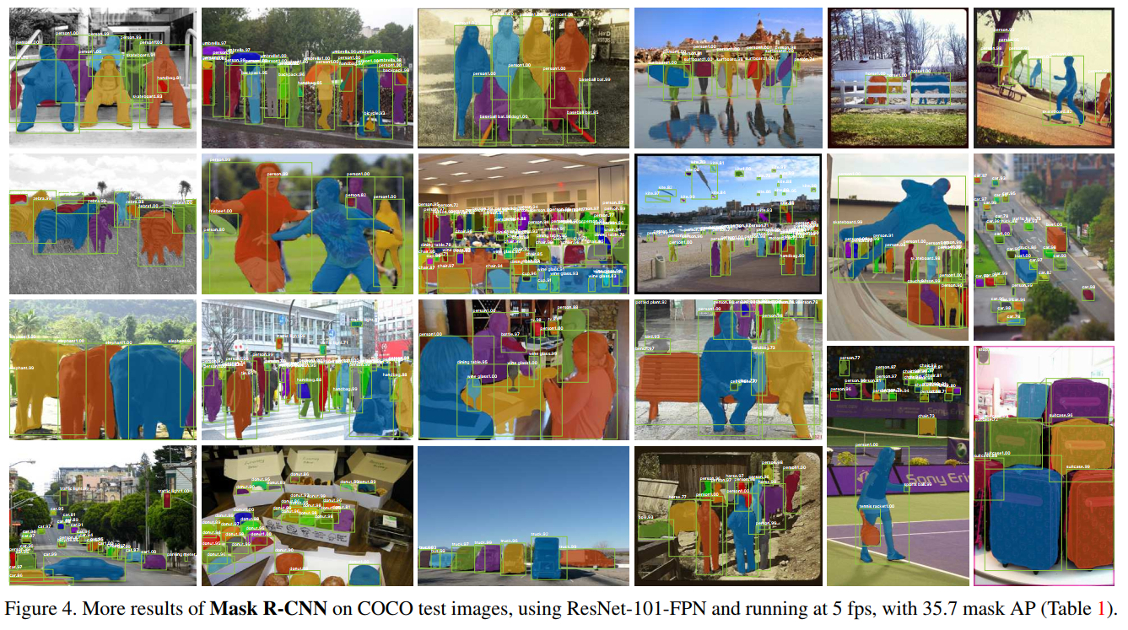
Mask R-CNN

Slide 33
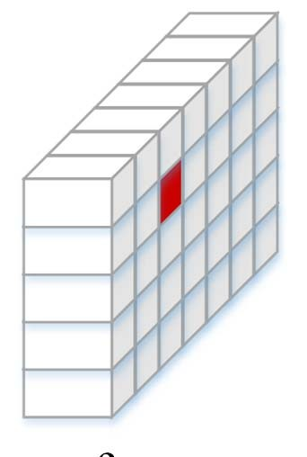
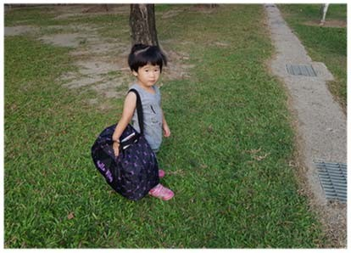
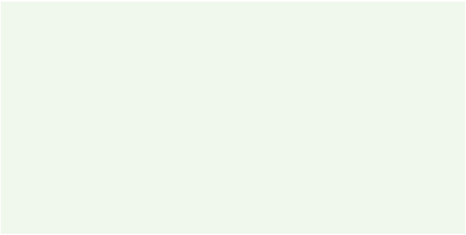


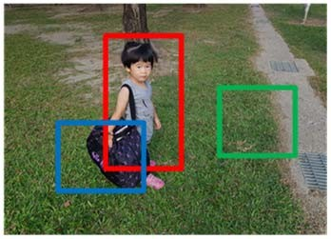

ROI Pooling & RoI Align
1st Stage: 计算可能包含物体的RoI
convolutional
feature map
2nd Stage: 提取RoIs对应的特征，并用用于后续的计算
2nd Stage
$$y=f(x)$$
1st Stage:
object parameter prediction
object class
bounding box
object mask
RoI feature
extraction
Region Proposal Network (RPN)
RoI Pooling
RoI Align
fixed size map for each RoI
object proposals

Slide 34

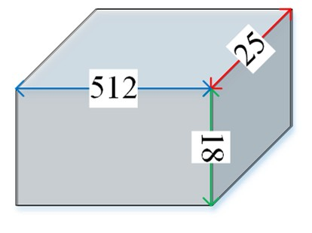



RoI Feature Extraction: input
Feature Map: 利用CNN计算输入图像的特征
806
scaling factor $s=\frac{1}{32}$
$$\left\lfloor \frac{806}{32}=25\right\rfloor$$
605
VGG-16
$$\left\lfloor \frac{605}{32}=18\right\rfloor$$
convolution
max pooling
conv. feature map
K. Simonyan et. al. “Very Deep Convolutional
Networks for Large-Scale Image Recognition,” ICLR, 2015.

Slide 35
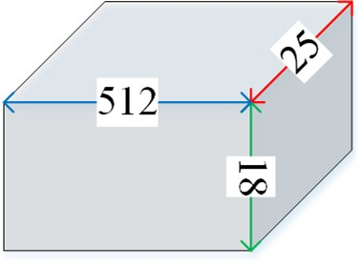
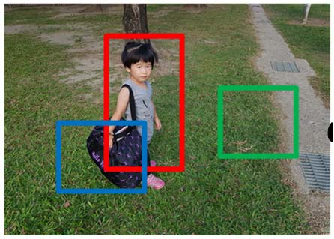
RoI Feature Extraction: input
RoI List: 利用RPN计算RoIs
Region Proposal Network (RPN)
Top left
Bottom right
1st RoI: (224, 89), (439, 426)
2nd RoI: (537, 217), (732, 383)
3rd RoI: (134, 312), (355, 489)
Ren, et. al., “Faster R-CNN: Towards Real-Time Object Detection with Region Proposal Networks,” NeurIPS, 2015.

Slide 36
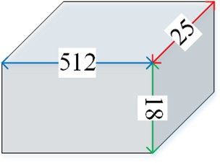
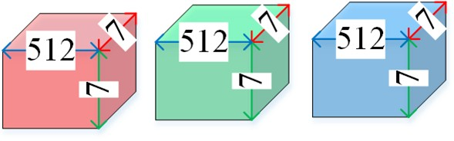


RoI Feature Extraction: output
将每一个RoI对应的转换成固定大小 $k×k×c$
$k$: (Faster R-CNN 7*7)
$c$: 特征通道数
RoI feature extraction
RoI Pooling
RoI Align

Slide 37
ROI Pooling - Steps
Step 1 (RoI mapping): 将RoI Bounding Box 的坐标从图像坐标映射到Conv层特征图
Step 2 (RoI division): 将映射后的RoI区域划分到网格 (grid)
Step 3 (max pooling): 对每一个网格内的特征提取最大值

Slide 38

Step 1: RoI mapping
通过RoI的坐标乘与特征大小的缩放系数s映射得到在特征图上对应的坐标位置
通过向上取整进行坐标量化
(224, 89)
806
$\left(\left\lfloor 224×\frac{1}{32}\right\rfloor ,\left\lfloor 89×\frac{1}{32}\right\rfloor \right)=(\left\lfloor 7.0\right\rfloor ,\left\lfloor 2.8\right\rfloor )$=(7, 2)
605
$\left(\left\lfloor 439×\frac{1}{32}\right\rfloor ,\left\lfloor 426×\frac{1}{32}\right\rfloor \right)=(\left\lfloor 13.7\right\rfloor ,\left\lfloor 13.3\right\rfloor )$=(13, 13)
(439, 426)

Slide 39

Step 1: RoI mapping
通过RoI的坐标乘与特征大小的缩放系数s映射得到在特征图上对应的坐标位置
通过向上取整进行坐标量化
(224, 89)
(7, 2)
806
18
605
(13, 13)
(439, 426)
25

Slide 40











Step 2: RoI division
将RoI映射后的特征width、height除以$k$
通过向下取整得到每一个grid的大小
(7, 2)
grid width: $\left\lfloor \frac{7}{3}\right\rfloor =2$
18
grid height: $\left\lfloor \frac{12}{3}\right\rfloor =4$
(13, 13)
25
$$k=3$$

Slide 41

Step 3: max pooling
取每一个grid里面的最大值
每一个特征通道单独进行计算
(7, 2)
max pooling
12
3
18
(13, 13)
3
7
25
$$k=3$$

Slide 42

RoI Pooling
不足之处:
采用取整操作会带来特征没有完全对齐
实例分割是需要精确的像素分割

Slide 43

ROI Align - Steps
Step 1 (RoI mapping): 将RoI Bounding Box 的坐标从图像坐标映射到Conv层特征图
Step 2 (RoI division): 将映射后的RoI区域划分到网格 (grid)
Step 3 (Interpolation): 通过插值的方式计算采样点的特征值 (每个grid有$s×s$个采样点)
Step 4 (max pooling): 对每一个网格内的特征提取最大值

Slide 44






Align Steps: mapping & division
RoI pooling
(7, 2)
RoI mapping: 乘以特征尺寸缩放因子
RoI division: 划分$k∗k$的网格
18
12
(13, 13)
7
25
(224, 89)
806
(7, 2.8)
grid width: 6.7/3=2.23
605
18
10.5
grid height:10.5/3=3.5
(13.7, 13.3)
6.5
$$k=3$$
(439, 426)
25

Slide 45




Align Steps: interpolation
每个grid分成$s×s$cells ($k$=2)
每个cell的对应的中心作为采样点
staring coordinate
displacement
$$x: 7.0 + \frac{2.23}{s=2}×\left(1+0.5\right)=8.673$$
$$y: 2.8 + \frac{3.5}{s=2}×\left(0+0.5\right)=3.675$$

Slide 46












Align Steps: interpolation
通过双线性插值(bilinear interpolation) 计算采样点的特征
$$(8.673, 3.675)$$
$$f(8.673, 3.675)$$
6.3
bilinear interpolation
18
25
13.3

Slide 47




Align Steps: max pooling
计算每个grid中采样点的特征最大值
每个通道单独计算
max pooling
3
18
3
25

Slide 48















线性插值（Linear Interpolation）
通过插值计算$f(p)$
$$f(p1)$$
$$f(p)$$
$$f(p2 )$$
$$f\left(p\right)=\frac{d_{2}}{d}×f\left(p_{1}\right)+\frac{d_{1}}{d}×f\left(p_{2}\right)$$
$$p1$$
$$d1$$
𝑝
$$d2$$
𝑝₂
𝒅
$$d$$

Slide 49


双线性插值（Bilinear Interpolation）
通过两次线性插值进行计算 (x方向、y方向)

Slide 50






RoI Align: Bilinear Interpolation
通过最近的四个特征值进行插值计算
$$f(8, 3)$$
$$f(9, 3)$$
$$f(8.673, 3.675)$$
18
$$f(8.673, 3.675)$$
$$f(8, 4)$$
$$f(9, 4)$$
25

Slide 51
Resource
Dai, et al. Instance-aware Semantic Segmentation via Multi-task Network Cascades, CVPR 2016
Lin et al. Feature Pyramid Networks, CVPR 2017
He, et al. Mask R-CNN, ICCV 2017
https://learnopencv.com/deep-learning-based-object-detection-and-instance-segmentation-using-mask-rcnn-in-opencv-python-c/

